Slide 1
Internet of Things
Michael Chi
Technical Evangelist

Slide 2
IoT is an Inflection Point
Hardware
is cheap
Connectivity
is pervasive
Development
is easy
Cloud can deal with big data
New Innovative Scenarios
Notes:
IoT is not that new, we’ve been connecting devices to networks and the internet for (probably) 25 or 30 years.
Hardware is Cheap
The cost of hardware has plummeted. This is part Moore’s law, part the explosive growth of high tech manufacturing, particularly in Asia. It is now cost effective to deploy hardware where we may not have before. Hardware is now more sacrificial than it has been in the past.
> Infrared/ambient temp sensor, ambient light, humidity, barometric pressure, 9-axis motion (accelerometer, gyroscope, compass), magnet
Connectivity is Pervasive
Somewhat related is the pervasive nature of cost effective connectivity. Particularly wireless connectivity. This is, in many ways, driven by the same forces driving the downward march of hardware costs.
Development is Easier
Reticent to say that Development is Easy. But, it is certainly easier. This is thanks to now being able to use rich programming tools, languages and environments across the full stack. Programming on embedded devices was traditionally done with assembler or C. It would have been unimaginable that we’d be using things like JavaScript as a first class programming language on hardware devices.
Cloud Can Deal with Big Data
In the past, many applications of telemetry and field sensors were limited by the computing power at the backend being able to store and process huge volumes of data. The cloud flips that problem. With the cloud we have effectively unlimited capacity on tap. We’re now in the situation where application scenarios are voracious for more data and the IoT helps us to get that data.
New Innovative Scenarios
And this whole set of factors is unlocking innovative new scenarios; at every level of every industry. Smart power grids, smart homes, smart factories and smart cars. One of the case studies we’ll look at later is even using IoT in agriculture to instrument smart cows.

Slide 3
IoT 2010
Alarm clock
Refrigerator
Automobile
VoIP phone
Computer
Printer
Media player
Microwave
HOME
WORKPLACE
HOME
Coffee maker
Smart scale
Oven
Cell phone
HVAC
Vending
Security
Television
Notes:
This has happened quickly
We had early generations of smart cars, smart refrigerators and smart WiFi scales
However, devices were isolated, stand alone and typically had their own exclusive ecosystem
Devices were typically expensive, or only certain models

Slide 4
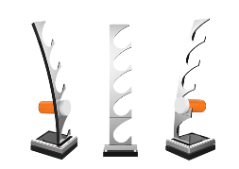
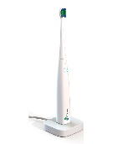
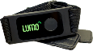
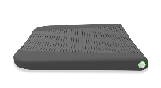
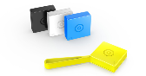
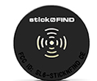
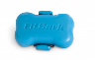

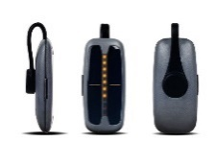
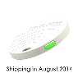
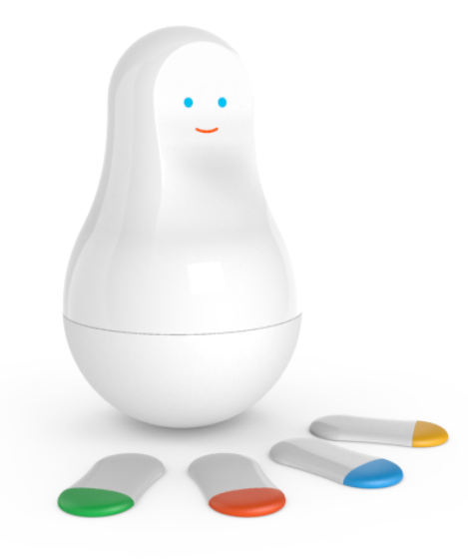
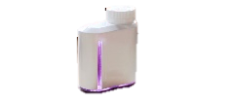
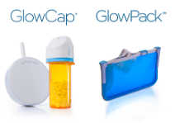
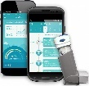
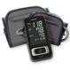
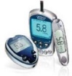
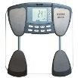
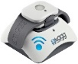
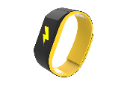
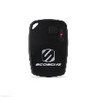

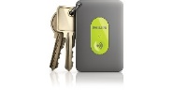
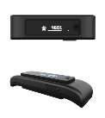



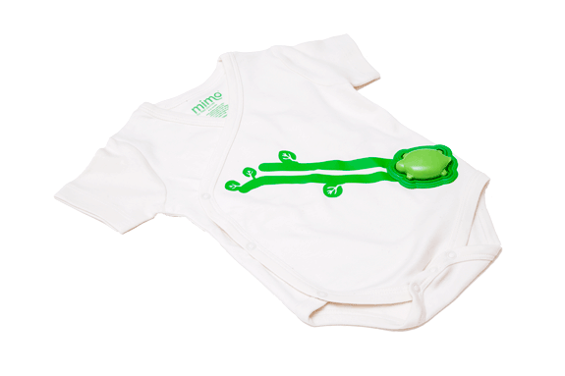
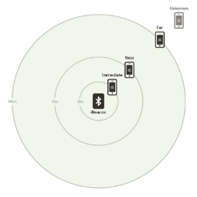
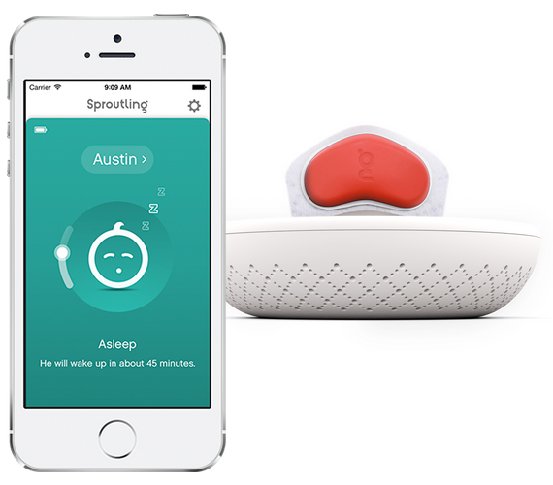

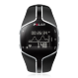
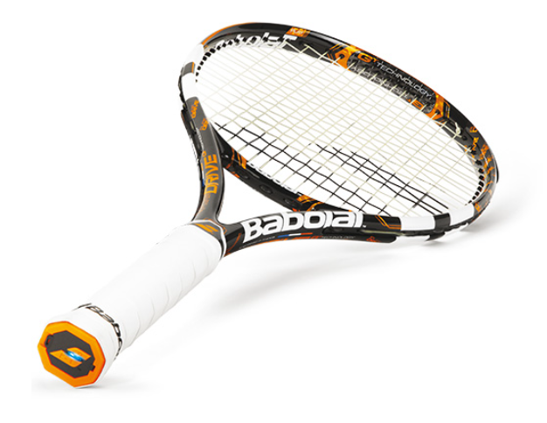
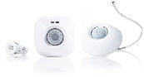
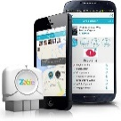
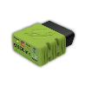
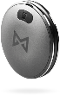
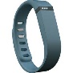
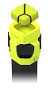
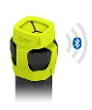
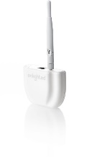
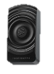

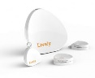
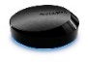
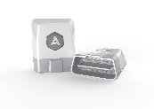
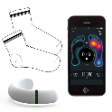
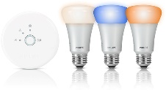
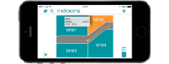
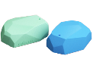
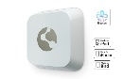
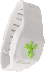
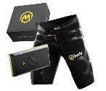
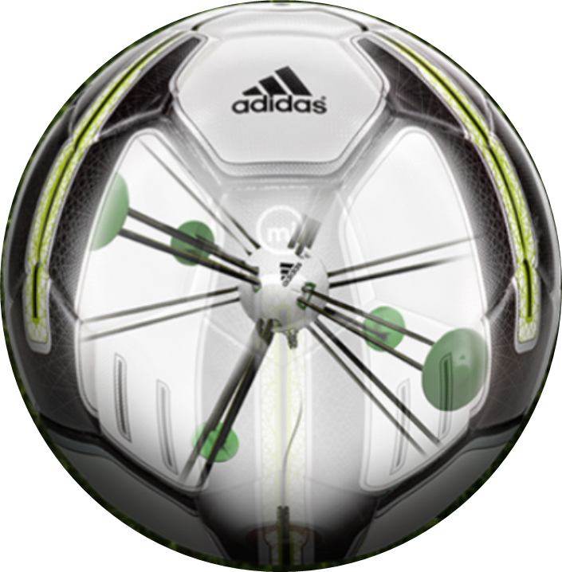


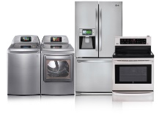
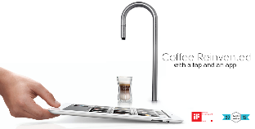
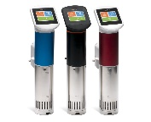
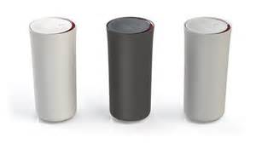












































IoT 2016
Medication adherence
Health monitoring
Pet tracking
Behavior modification
Object tracking
Child and elder monitoring
Sports and fitness
Indoor navigation
Trip tracking and car health
Smart lighting
Beacons and proximity
COMMUTE
COMMUTE
HOME
WORKPLACE
HOME
Smart appliances
Food and nutrition tracking
Identity
Office equipment
Smart vending machines
Bike ride stats and protection
Air conditioning and temperature control
Sleep tracking
Environmental sensors
Information capture
Control
Home security
Home automation
Leak detection
Garden, lawn and plant care
New devices and sensors
Entertainment systems
Notes:
- Ecosystems are integrated. Customers expect their phone to work with their watch and their car and their coffee machine.
Boundary is blurring between ‘work’ & ‘play’… many devices have a dual purpose
There are many more devices at the smaller & cheaper end of the spectrum. Not unusual to have network connectivity in a device costing a few bucks.
The explosion of new smart hardware devices needs to be supported by a broad, hyperscale service back-end to allow the integration between hardware ecosystems.

Slide 5

25 BILLION Connected “things” will be in use by 2020
$7.2 TRILLION worldwide market for IoT solutions by 2020
IDC: Worldwide and Regional Internet of Things (IoT) 2014–2020 Forecast
Gartner
Notes:
Various estimates of market size and all of the large analyst firms are taking an active interest.
Discuss Gartner number
Over 3 connected things for every man, woman and child on earth
Discuss IDC number

Slide 6

Disruptive Forces
Moore’s Law
Metcalf‘s Law
Koomey’s Law
Transistors
Computations
per KWh
10,000,000,000
1.E+14
1,000,000,000
1.E+12
100,000,000
1.E+10
10,000,000
1.E+08
1,000,000
1.E+06
100,000
1.E+04
10,000
1.E+02
1,000
1.E+00
1970
1980
1990
2000
2010
1940
1975
2010
And more importantly:
what can you do by combining and analyzing signals from all of these IoT devices?
Notes:
None of these are Laws (like gravity) as much as rules of thumb.
Moore’s Law https://en.wikipedia.org/wiki/Moore%27s_law
The number of transistors in a dene integrated circuit (like a CPU but also other microprocessors and other things critical to IoT) roughly doubles every 2 years. Important to call out that both sides of the relationship; this is giving us not only faster smartphones. It also means that the cost of integrated circuits keeps being driven down… making things cheaper and cheaper
- i.e. After every two years, you can have twice the processing power for the same money, or you can have the same processing power for half the money.
Metclaf’s law https://en.wikipedia.org/wiki/Metcalfe%27s_law
The value of a telecommunications network is proportional to the square of the users. Connecting more things is very valuable and there are strong ‘network effects’. The best social network is the one that all of your friends also use, the best fitness tracker is the one on which you can compete with the most people. IoT is about connecting more and more things and in many cases more and more people.
Koomey’s Law https://en.wikipedia.org/wiki/Koomey%27s_law
Talks about the improving efficiency of computation. It’s related somewhat to Moore’s law. It talks about the number of Joules of energy per unit of computation. Energy efficiency is critical for the IoT because it allows more devices to be wireless and battery powered; indeed many IoT devices are wireless and disposable, running on a disposable battery for a period of time before being discarded.

Slide 7
IoT Business Maturity Model 1. Operational efficiency
Connect devices and monitor telemetry
Monitor and track device state, location and health
Things
Rules and alerting to improve operational efficiency
Notes:
Most customers adopting the IoT tend to follow a similar pattern.
- It starts with organizations hunting for operational efficiency.
- Subsequently they begin by connecting devices and capturing data. The cloud means that traditional concerns about ‘too much data’ are much less prevalent.
- Customers will be monitoring the IoT devices themselves and the things they they’re connected to.
Often customers will be using real time rules and alerting to make decisions in an ad hoc fashion about their things.

Slide 8
IoT Business Maturity Model 2. Business Intelligence
Analyze and visualize data from devices
Discover patterns in device data using predictive analytics
Things
Operationalize insights to improve things and processes in real time
Notes:
Next, organizations start to develop some business intelligence around the huge streams of data.
Once they’ve built a data set customers will start to derive insight from this. This moves from experimentation and exploration of data to insight, often using machine learning and other statistical and predictive models.
The cloud and predictive analytics work really well together. This is because predictive analytics requires a lot of computing power, which is ‘on tap’ in the cloud.
Insight allows customers to take better decisions as they run their business. Some of these will be real time operationalization of predictive models, some of these will be longer term strategic decisions.

Slide 9
IoT Business Maturity Model 3. Business Transformation
Combine IoT & other data with advanced analytics to power new services and revenue streams
Expand into new adjacent businesses
Things
New partnership opportunities
Notes:
Customers then integrate IoT into their broader business and explore new areas in which to deploy IoT solutions.
Data and devices in the field unlock new opportunities to partner with other organisations who’re also interested in the hardware platforms and data streams.
The cycle continues.

Slide 10







IT / OT Collaboration
Operational Technology (OT)
Information Technology (IT)
Notes:
Operational technology has been around for a long time, smart systems, industrial control and automation are not new.
But, traditionally Operational Technology has been isolated from more traditional Information Technology.

Slide 11
IT / OT Collaboration Enables IoT
Enterprise
Notes:
It is the collaboration of Operational Technology and Information Technology that really enables the IoT.

Slide 12
Collaboration & Cyberphysical Security
IT Engineers
OT Engineers
Know how to make digital things secure.
Secure Development Lifecycle
Secure Network Technologies
Threat & Vulnerability Mitigation
Monitoring and Alerting
Software/Firmware Auto-Updates
Privacy Models
Know how to make physical things safe and secure
Standards, Procedures, Training, Continuous Improvement
Physical access management
Hazard and Risk Analysis
Monitoring and Maintenance
Fail Safe and Safety Equipment
IT and OT engineers will collaborate in making “cyberphysical” systems safe and secure.
Notes:
A great example of why this collaboration is important is security.
I.T. Engineers are very capable of securing digital things.
O.T. Engineers are very capable of securing physical things.

Slide 13



IoT Devices & Cloud Patterns
Notes:
What are some of the patterns that we are seeing within customers and within partners around the use of IoT devices?

Slide 14
Cloud Based IoT Solutions
Azure IoT
Easy to provision, use and manage
Pay as you go, scale as you need
Global reach, hyper scale
End to end security & privacy
Three parts of an IoT solution
1 | Device connectivity & management
2 | Analytics & operationalized insights
3 | Presentation & business connectivity
Notes:
A lot of businesses have been building IoT solutions with Azure, using a variety of Azure’s services over the years.
Why is Azure and the cloud so popular?
- Easy to provision, use and manage
- …
We see three key areas in an IoT solution:
- Device connectivity and management
- …

Slide 15
IoT Device & Cloud Patterns
Cloud Gateway
Event/IoT Hubs
Event Hubs
High scale telemetry ingestion service
HTTP/AMQP protocol support
Each Event Hub supports
1 million publishers
1GB/s ingress
Generally available worldwide
Tens of Billions of messages per day
Tens of TB ingested per day
And rising…
Devices
RTOS, Linux, Windows, Android, iOS
Notes:
A number of businesses have built IoT solutions using Event Hubs.
Event Hubs are a high scale messaging service.
Really high message throughput.
Deployed and used all over the world everyday.
However after working with customers we found that they needed more than Event Hubs alone.

Slide 16
IoT Device & Cloud Patterns
Cloud Gateway
Event Hubs
&
Azure IoT Hub
Additional IoT Needs
Command & control
Device identity
Device registry
Device and State management
Protocol translation and gateways
Protocol Adaptation
Field Gateway
Protocol Adaptation
Devices
RTOS, Linux, Windows, Android, iOS
Field Gateway
Device
Connectivity & Management
Notes:
Customers needed components to deal with
- Command and control
- …
Many projects are not greenfield, rather they involve support for existing devices and protocols.

Slide 17
IoT Device & Cloud Patterns
Azure IoT Hub
Bi-directional device <-> cloud
Up to 10 million devices
Telemetry ingestion
Command & control
Device registry & identity
Bulk import/export of device identities
Device Management
HTTP/AMQP/AMQP-WS/MQTT
Extensible protocol support
Operations Monitoring
Cloud Gateway
Azure IoT Hub
Protocol Adaptation
Field Gateway
Protocol Adaptation
Devices
RTOS, Linux, Windows, Android, iOS
Field Gateway
Device
Connectivity & Management
Notes:
The Azure IoT Hub extends the capabilities of Event Hubs to target IoT workloads.
Native support for MQTT: Azure IoT SDKs (or OSS libs) can connect to IoT Hub using MQTT (no protocol gateway needed).
AMQP over WebSockets: Use AMQP through firewalls.
Operations Monitoring
Device connection/disconnection events
Device error reporting
Event Hub-compatible endpoint
Example: complex device blocking logic
Stream Analytics job evaluates: number of failed connection attempts per device
As a result device can be disabled in IoT Hub

Slide 18
IoT Device & Cloud Patterns
Cloud Gateway
Event Hubs
&
Azure IoT Hub
Cross-Platform
Device Support
Open source “agent” framework
Simple, secure device <-> cloud connectivity & management
RTOS, Linux, Windows, Android, iOS
Easy to use, not required
Protocol Adaptation
Field Gateway
Protocol Adaptation
Devices
RTOS, Linux, Windows, Android, iOS
Field Gateway
C API
.NET API
Java API
Javascript API
Cross Platform C Code
Device
Connectivity & Management
OS Abstraction Layer / OS Bindings
Notes:
The goal was to support the broadest set of device platforms possible.
Started with cross platform C code which you can port onto almost any platform.
Successfully ported onto RTOS, Windows, Android, iOS…
There are several APIs available to use.
There is no requirement to use any of the existing code.
It is all open source, on GitHub, and freely extendable.

Slide 19





IoT Device & Cloud Patterns
Batch Analytics & Visualizations
Azure HDInsight, AzureML, Power BI,
Azure Data Factory, Azure Data Lake
Cloud Gateway
Event Hubs
&
Azure IoT Hub
Hot Path Analytics
Azure Stream Analytics, Azure HDInsight Storm
Protocol Adaptation
Hot Path Business Logic
Service Fabric & Actor Framework
Operationalize your insights in real time
Field Gateway
Protocol Adaptation
Devices
RTOS, Linux, Windows, Android, iOS
Find insights to
Power new services
Improve your “things”
IoT Scale
Object Models & Business Logic
Field Gateway
Device
Connectivity & Management
Analytics &
Operationalized Insights
Notes:
Of the three ‘typical’ components in an IoT solution, the next to think about is Analytics and operationalising insight.
Azure provides a broad range of sophisticated technologies for delivering analytics.
With Hot Path Analytics you’re able to process real time event streams coming out of your IoT solution.
Then there are tools and technologies for building large scale systems on top of your IoT device in the field.
Finally: IoT applications do not live in isolation, they’re going to be part of a broader consumer or business eco-system.

Slide 20

IoT Device & Cloud Patterns
Batch Analytics & Visualizations
Azure HDInsight, AzureML, Power BI,
Azure Data Factory, Azure Data Lake
Cloud Gateway
Event Hubs
&
Azure IoT Hub
Hot Path Analytics
Azure Stream Analytics, Azure HDInsight Storm
Presentation &
Business Connectivity
App Service, Websites
Dynamics, BizTalk Services, Notification Hubs, Logic Apps
Protocol Adaptation
Hot Path Business Logic
Service Fabric & Actor Framework
Field Gateway
Protocol Adaptation
Devices
RTOS, Linux, Windows, Android, iOS
Field Gateway
Device
Connectivity & Management
Analytics &
Operationalized Insights
Presentation &
Business Connectivity

Slide 21
Azure IOT Architecture

Slide 22
Microsoft Azure IoT Platform
On-Pre,
Azure
Protocol Bridge
D2C Ingestion
C2D Messaging
Device Registry
Device Identity
Device Provisioning
Real-time Processing
cv
cv
cv
Client Connectivity
Storage
Event Ingestion
Data Analytics
Predictive Analytics
Dashboards
Process Automation
Stream Analytics
AMQP/AMQP over WebSocket
, HTTPS, MQTT
AMQP
BLOB
Devices
SQL DB
Notification Hub
QUEUE
Azure ML
IoT Hub
HDInsight STORM
Document DB
Logic Apps
Event Hub
Power BI
Field Gateway
Web Apps
HDInsight
Event Processor Host
Data Lake
Mobile Apps
AMQP/AMQP over WebSocket
, HTTPS, MQTT
AMQP
Data Factory
{ SDK – .NET C#,
JS, C, JAVA, Python }
{ OS - Win, Android, iOS, Linux,
RTOS, MBED }
Key IoT Capabilities and Technologies

Slide 23
IoT Related Azure Offerings
Notes:
Let’s drill into the IoT related offerings in the Microsoft Azure platform.
- We’ll do that in the context of the Azure IoT reference architecture.

Slide 24
Azure IoT Reference Architecture
Devices and Data Sources
Data Transport
Device and Event Processing
Presentation
Cloud Gate-way
Data Visualization & Presentation
IP capable devices
Provisioning API
Solution Portal
Device State Store
Agent Libs
Identity & Registry Stores
Existing IoT devices
Stream Event Processor
Agent Libs
Gateway
Storage
Analytics/ Machine Learning
Low power devices
Agent Libs
Control System Worker Role
Notes:
Common patterns appear when inspecting the sorts of solutions people build to implement IoT.
Different types of devices are requiring different approaches for connectivity.
Some are connected directly
Others require gateways to mediate protocols.
Some sort of cloud messaging gateway is used.
Common requirements around:
Device provisioning
Solution portals
Mechanisms to register devices
Stream processing tools
Storage
Analytics
Presentation

Slide 25
















Microsoft Azure IoT services
Devices | Device Connectivity | Storage | Analytics | Presentation & Action
 | Event Hubs | SQL Database | Machine Learning | App Service
 | IoT Hubs | Table/Blob Storage | Stream Analytics | Power BI
 | Service Bus | DocumentDB | HDInsight | Notification Hubs
 | External Data Sources | External Data Sources | Data Factory | Mobile Services
 |  |  |  | BizTalk Services
{ }
Notes:
We then think about the different services within Azure IoT that are useful for implementing the Reference Architecture.

Slide 26
Azure IoT Reference Architecture
Devices and Data Sources
Data Transport
Device and Event Processing
Presentation
Cloud Gate-way
Data Visualization & Presentation
IP capable devices
Provisioning API
Solution Portal
Device State Store
Agent Libs
Identity & Registry Stores
{ }
Existing IoT devices
Stream Event Processor
Agent Libs
Gateway
Storage
Analytics/ Machine Learning
Low power devices
Agent Libs
Control System Worker Role
Notes:
How to the Azure IoT services map to the Reference Architecture?
There’s not necessarily a direct mapping of a service to a component of the reference architecture. Often there are different options for each component.
Cloud gateway -> Azure IoT Hubs
Event processing -> Stream analytics
Storage -> DocumentDB, SQL etc
Machine Learning -> Azure Machine Learning
Registry Store -> DocumentDB
Solution Portal -> Azure App Service
Data Visualization -> MS Office, Power BI

Slide 27
Microsoft Azure IoT Suite
Notes:
There are many different ways to solve IoT problems, but it would be very useful to provide some prescriptive guidance and a mechanism to allow customers to very quickly build out these solutions.
The problem with building out a software as a service approach is that the richer you make the SaaS, often the harder it is to customize to particular needs.

Slide 28
Microsoft Azure IoT Suite
Connect and scale
with efficiency
Analyze and act
on new data
Integrate and transform
business processes
Preconfigured solutions
Event processing
Workflow integration
Heterogeneous agents
Predictive analytics
Push and broadcast notifications
Connect and control
Data visualization
ID and access management
Notes:
The goal of the Microsoft Azure IoT Suite is to provide a concrete implementation of the Reference Architecture using the Azure IoT services.
The Microsoft Azure IoT Suite offers a solution to three key pillars;
Connect and scale with efficiency
Preconfigured solutions offer quick start-up provisioning to the most common IoT scenario requirements.
Heterogeneous agents libraries, documentation and SDK’s allow for OS selection and cross platform, multi language support. Easily flash devices and create custom agents using open source libraries.
Connect and control devices easily, handling device authentication and secure two way communication.
Analyze and act on new data
Set thresholds, alert limits and values and alarm jobs while processing big data.
Implement predictive analytics and algorithms across historical and real time data for a variety of purposes.
Visualize big data on dashboards or create reports for business decision makers.
Integrate and transform business processes
Integrate alarms, real time processes and elevate attention within new or existing line of business applications.
Broadcast notifications and commands to devices or personnel; utilize geographic or other custom features to target audiences.
c) Make dashboards and data available but control security and access to devices, thresholds and alert configurations.

Slide 29








Microsoft Azure IoT Suite
Accelerate your business transformation
Azure IoT services
Azure IoT Suite
Enables you to
Connect assets
Mine data
Take action
Addresses
common scenarios:
Monitoring
Remote Monitoring
Predictive Maintenance
And more…
Notes:
The Microsoft Azure IoT Suite doesn’t lock you into a particular way of doing things. It provides an implementation of the Reference Architecture, using Azure IoT services which is totally configurable.
It’s not a service. It’s a solution accelerator.

Slide 30



Accelerate time to value with preconfigured solutions
Start quickly with preconfigured solutions
Finish with your Internet of Things application
Get started in minutes
Fine-tuned to specific assets and processes
Modify existing rules and alerts
Highly visual for your real-time operational data
Add your devices and begin tailor to your needs
Integrate with back-end systems
Notes:
Another area of our focus, a point of differentiation, are the preconfigured solutions.
Within Azure IoT Suite, we’ve provided preconfigured solutions that enable you to quickly get started with common IoT scenarios such as remote monitoring, asset management and predictive maintenance.
You basically get a curated experience for these scenarios
With a pre-provisioned dashboard, rules and events engines and a device registry.
You can add new devices, change rules and quickly get started to proof of concept (PoC).
This really allows you to get the end point, i.e. building your IoT solutions.
For example, you get started quickly with the remote monitoring solution that you then tailor to your needs and convert it into a fleet management solution.
This solution is finely tuned for your needs, etc.
Our goal with these preconfigured solutions is to help you accelerate time to value and reach your end point much faster because we’ll give you a good base to start building from.

Slide 31

Solution #1: Remote Monitoring
Connect and monitor your devices to analyze untapped data and improve business outcomes by automating processes
Supports telemetry, C&C, rules/alerting, data viz., basic device registration

Slide 32
Architecture
Azure IoT Suite Remote Monitoring
Web/Mobile App
Power BI
Devices
Back end systems and processes
Storage blobs
DocumentDB
C# simulator
IoT Hub
Stream Analytics
Event Hub
Web Jobs
Logic Apps
Azure
Active Directory
Notes:
What you get with the remote monitoring preconfigured solution:
- The goal is to get up and running in minutes.
As mentioned; the solution is a combination of multiple back-end components. This architecture diagram shows the individual Microsoft products and services that are utilized.
Power BI & Logic Apps are commonly used but not actually provisioned by the suite
Reference Architecture for Remote Monitoring solution, what products are used and why?
Provision simulated devices with a C# device emulator running .Net. Create agents for Linux, iOS, Android and other platforms with C and Java language support.

Slide 33
Components
Azure IoT Suite Remote Monitoring
Gateway: device connection point
Cold analytics: raw data
Hot analytics: summarized data
Commands: C2D requests
Actions: business logic
Registry: identity + device
Web/Mobile App
Power BI
Storage blobs
DocumentDB
IoT Hub
Stream Analytics
Event Hub
Web Jobs
Logic Apps
Azure
Active Directory
Notes:
IoT Hub manages the two way communication between cloud and device and creates a secure command and control channel.
Azure Stream Analytics creates and manages jobs to recognize threshold values or detect alarm triggers, sending this information where it needs to be escalated.
Event Hub is queried by a web job running an event processor host to determine where and alarm or alert needs to be pushed – such as sending an alert to dashboard for a human operator to take action.
Logic Apps are used to create more complex work loads and integrate into line of business and other proprietary applications.
Document DB stores all the metadata and device properties for each connected device.
Blobs store telemetry information and telemetry data. Other tools such as Azure Machine Learning and PowerBI can access this information for data visualization or processing advanced analytics.
Webapp – Dashboard code is available in Github allowing it to be fully customized by the user to align with a scenario or be relevant for an enterprise application.
Azure Active Directory controls user IDs and access, allowing the service to be shared with relevant decision makers within the business but restrict access to certain controls or devices.
PowerBI is used for both open-source embedded components within the dashboard and also for complex external analytics of trends and patterns across all stored data.

Slide 34
Data
Rules Thresholds
Telemetry Summary
Avg, Min, Max
IoT Hub
Azure Stream Analytics
Telemetry
Telemetry Job
Raw Data
Web Application
C# simulator
Dashboard
Device Info
Rules Job
Telemetry
Event Hub
Alarms
Device Info Job
Device Manager
Commands
Web Job
Telemetry
Rules
Device Info
C&C
Event Hub
Event Processor
Document DB
C# Simulator
Device Registry

Slide 35
Security
Azure IoT Suite Remote Monitoring
Device: unique SAS to sign messages, over TLS
Users: federated authentication via Azure Active Directory
Services: key-based auth
Platform (ARM): AAD + RBAC
Web/Mobile App
Power BI
Storage blobs
DocumentDB
IoT Hub
Stream Analytics
Event Hub
Web Jobs
Logic Apps
Azure
Active Directory

Slide 36

Integrate – business processes
Azure IoT Suite Remote Monitoring
Logic Apps: WYSIWYG integration
Azure (Service Bus, Blob, …)
Office (incl. Dynamics)
SalesForce CRM
BizTalk (X12, EDIFACT, AS2, …)
And more (custom, FTP, Twilio)
Functions: event-driven compute on demand
Web Jobs + Event Hubs: listen to near-raw event stream
Web/Mobile App
Power BI
Storage blobs
DocumentDB
IoT Hub
Stream Analytics
Event Hub
Web Jobs
Logic Apps
Azure
Active Directory
Functions

Slide 37

Integrate – data insight
Azure IoT Suite Remote Monitoring
SQL Data Warehouse: read via PolyBase or ingest
HDInsight: analyze in Hive, HBase, Spark; process in Storm
Data Lake (+ Analytics): store beyond the bounds of a single storage account; analyze big data on demand with USQL
Data Factory: ETL for the cloud where direct connect not available
Machine Learning: batch & real-time predictions
Web/Mobile App
Power BI
Storage blobs
DocumentDB
IoT Hub
Stream Analytics
Event Hub
Web Jobs
Logic Apps
Azure
Active Directory
SQL DW
HDInsight
Data Lake
ADF
ML
Notes:
IoT Suite doesn’t sit in isolation

Slide 38

Solution #2: Predictive Maintenance
Anticipate maintenance needs and avoid unscheduled downtime by connecting and monitoring your devices for predictive maintenance

Slide 39
Architectural Differences
Added
Machine Learning: model, real-time predictions
Portal: simulation data visualization
Removed
Device Registry: fixed set of simulated sensors only
Rules & Alerts: all data passed to ML for analysis

Slide 40
Planning
Notes:
Case Studies
- Customers who’ve been using Azure IoT Services and Azure IoT Suite to improve their business and unlock new value.

Slide 41
Scale
Data Ingest
IoT Hub
6M 4KB msgs per day
ASA
1 MB/s unit
Event Hub
1 MB/s unit in, 2MB/s unit out
Web Jobs
Instance
Data Egress
Web
Instance
IoT Hub
6M 4KB msgs per day
+ automated actions
Notes:
Modern cloud solutions => architect as the economist
It’s a pipeline; don’t let it slow down; if your devices don’t send uniformly then provision capacity correctly

Slide 42
Pricing
Service | Measure | Monthly Price | Notes
IoT Hub | 6M msgs/day; ~24GB | $500/unit | Smaller unit size available; up to 200 units
Stream Analytics | 1 MB/s per unit + per GB processed | $22.30/unit (3) + $0.001/GB
Event Hubs | 1 MB/s ingress & 2 MB/s egress per unit + per message received | $22/unit + $0.028/million ingress events | Smaller unit size available
Storage | Per GB | $0.024 - $0.061/GB
App Service | Per instance | S1 = $74 (x2) P1 = $223 (x2)
DocumentDB | Per collection | S1 = $25
TOTAL (NO ACTIVITY) |  | $1,190 | ~$40/day
TOTAL (6M msgs/day) |  | $1,225 | ~$41/day
Notes:
Provisioned capacity: use it or lose it; guaranteed performance but need to be able to accurately forecast device input

Slide 43
Case Studies
Notes:
Case Studies
- Customers who’ve been using Azure IoT Services and Azure IoT Suite to improve their business and unlock new value.

Slide 44


Fueling the oil and gas industry with IoT
CHALLENGE
SOLUTION
BENEFITS
Rockwell Automation is the world’s largest industrial automation and information firm with 22,500 employees and customers in more than 80 countries. Rockwell Automation wanted to transform the way they do business in the oil and gas industry by bringing the data generated by even the most remote assets into the cloud and using advanced analytics to provide unprecedented business insights.
Rockwell Automation created a solution to monitor expensive capital assets and use that data to improve operational efficiency, drive better performance and enable innovation. Based on Microsoft Azure Internet of Things services, the solution collects, integrates, and organizes sensor data from remote equipment across global supply chains to support real-time insight, predictive analytics, and preventive maintenance.
Improves access to production and supply chain data worldwide, reducing downtime costs by as much as $300,000 per day
Modernizes transaction data by replacing a paper-based system with immediate electronic records
Enables data insights that help customers orchestrate everything from deliveries to equipment maintenance
“What we’re talking about is delivering a degree of collaboration and visibility unheard of in the oil and gas industry.”
Doug Weber Business Manager, Remote Application Monitoring
ROCKWELL AUTOMATION
Notes:
Rockwell Automation have been using IoT technologies for a number of years.
Rockwell are a large provider of industrial control systems.
Used Azure to connect their existing automation systems to the cloud, enabling them to drive predictive maintenance to improve operational efficiency.

Slide 45


Transforming subatomic research with IoT
CHALLENGE
SOLUTION
BENEFITS
Operated by Stanford University for the United States Department of Energy, the SLAC National Accelerator Laboratory is a 50-year-old, two-mile-long particle accelerator and research center. Over the years, six scientists have received Nobel prizes for work conducted there. To ensure continuous availability of this critical scientific resource and keep it running as smoothly as the day it was built, SLAC teams are collaborating to explore the Internet of Things (IoT).
SLAC is collecting data from intelligent sensors and feeding it into the cloud where it can be analyzed for early detection of anomalies — allowing engineers to anticipate problems, take action and prevent failure. Working with Microsoft Open Technologies, SLAC used the open-source project ConnectTheDots.io to integrate the diverse array of sensor formats in one of its klystron cooling systems. Azure Event Hubs then packages and routes the data to Azure Machine Learning for near-real-time analysis.
Keeps science accelerating by collecting and analyzing potentially millions of data points in near-real time to predict potential failure
Helps technicians understand how disparate systems interoperate, so they can upgrade more strategically and avoid downtime
Continually increases precision by feeding information back into Azure Machine Learning on the root causes of detected anomalies
“The advantage we gain is that the algorithms can look through everything at once and just return the things we actually need to focus on, so we can take action.
Marcus Keenan
Manager of Instrumentation and Controls for Facilities and Operations
SLAC National Accelerator Laboratory
Notes:
The Stanford University S-L-A-C National Accelerator Laboratory.
This is a particle accelerator laboratory which is a very expensive asset.
Stanford University have been using Azure to perform predictive maintenance on the technology that supports their accelerator.
This helps to avoid downtime.
Azure is able to scale to support millions of data points in real time to predict failure, and use that model to help minimize downtime.

Slide 46

Using IoT to flush out inefficient processes for Monterey Water
CHALLENGE
SOLUTION
BENEFITS
The Monterey Regional Water Pollution Control Agency is one of the nation’s largest water recycling facilities for crop irrigation—treating 20 million gallons daily. Monterey wanted to find out why their facility was experiencing unusually high energy usage but didn’t have the data necessary from their existing control systems. They wanted to avoid expanding their existing control system —taking many months and hundreds of thousands of dollars—opting to seek an IoT solution instead.
Candi Controls created a solution for MRWPCA that was running within 30 days and that cost less than $40K. Commercial-class IoT submeters were placed at 20 key plant processes to measure energy usage at 30 second intervals providing the granular, real-time data Monterey Water needed to optimize plant processes. The existing deployment is being enhanced with Azure Stream Analytics and Power BI to better manage and optimize energy usage in future.
Provided $160K in deployment savings and was up and running within 30 days, needing only onsite electricians to install.
Created 140,000 data points daily, enabling analyses of inefficient processes to save energy costs.
Expansion of system with Azure Stream Analytics and Power BI to provide process scenario simulations using real data.
“Using off-the-shelf sensors with the Candi IoT Platform gave Monterey Water the data they needed to realize significant energy savings & power demand reduction.”
Steve Raschke CEO, Candi Controls, Inc.
CANDI CONTROLS
Notes:
CANDI is using Azure to support Monterey Regional Water Control Agency
They have a broadly deployed IoT solution.
They’ve seen very significant cost and efficiency savings by being able to track far more data from across their plant in a single location.

Slide 47


The connected cow: Using IoT to transform cattle production
CHALLENGE
SOLUTION
BENEFITS
Fujitsu is the world’s fourth-largest IT services provider with approximately 162,000 employees in more than 100 countries and holds about 97,000 patents worldwide. Fujitsu wanted to help dairy farmers increase production, improve data insights and transform their business by optimizing the timing of artificial insemination (AI). It also wanted to decrease loss through early detection of health issues.
Fujitsu learned from public research that a cow produces more estrus (goes into heat) 16 hours after the number of steps increases significantly. The company created an innovative solution which uses a rugged pedometer with a five-year battery to measure the number of footsteps a cow takes, then sends that data to the cloud for analysis to determine optimum AI timing and even affect calf gender. In addition, the patterns of steps can detect disease in cattle. Alerts are delivered to the farmer’s cell phone.
Improves calf production up to 31%, with an average of 12%
Modernizes data access with mobile phone alerts, reducing labor costs for monitoring cows
Transforms herd management by allowing farmers to increase chances of producing a male or female calf
Reduces loss by detecting 8-10 different kinds of diseases in cattle
FUJITSU
Notes:
Fujitsu in Japan have been working on a ‘smart cow’ solution.
Cows in the field are equipped with pedometers, similar to the wearables that we have.
The pedometer information is used to determine the best time for breeding.
This is allowing them to:
Significantly improve calf production
Detect disease early in the cow.
All case studies examined here can be found at www.InternetofYourThings.com
Now let’s get into having a look at Azure IoT Services and the Azure IoT Suite in a hands on fashion via the hands on labs.

Slide 48

© 2013 Microsoft Corporation. All rights reserved. Microsoft, Windows, Windows Vista and other product names are or may be registered trademarks and/or trademarks in the U.S. and/or other countries.
The information herein is for informational purposes only and represents the current view of Microsoft Corporation as of the date of this presentation. Because Microsoft must respond to changing market conditions, it should not be interpreted to be a commitment on the part of Microsoft, and Microsoft cannot guarantee the accuracy of any information provided after the date of this presentation. MICROSOFT MAKES NO WARRANTIES, EXPRESS, IMPLIED OR STATUTORY, AS TO THE INFORMATION IN THIS PRESENTATION.

